Slide 1

The Hearing
MODULE 5G
Notes:
Hello and welcome to Module 5G, The Hearing.

Slide 2
Overview
Before the Hearing
  Ensure Privacy
  Give Notice and Action
  Record the Hearing
During the Hearing
  Ask Effective Questions
  Determine Relevance
  Determine Credibility
  Understand the Preponderance of Evidence Standard
  Conduct Cross-Examination
After the hearing
  Determination
Notes:
Overview – We will first discuss the important steps needed to be taken before the hearing including ensuring privacy, giving notice and recording the hearing. After that, we will discuss important guidelines related to asking effective questions, determining relevance, determining credibility, understanding the preponderance of Evidence Standard and conducting cross examination. Finally, we will cover the written determination and all its important steps.

Slide 3
Before the Hearing
Module 5G

Slide 4
Ensure Privacy
Ensure that the hearing is being held in a private space, either in-person or virtual.
Arrange for each party to have their own private areas and access to restrooms
Uphold confidentiality and use discretion when preparing for the Hearing
Notes:
Ensure that the hearing is being held in a private space, either in-person or virtual. For example, private conference rooms and other private rooms that have minimal foot traffic around them are appropriate venues to conduct a hearing.
Arrange for each party to have their own private areas and access to restrooms. It is recommended that you provide a private office for each party to use in near proximity to where the hearing is being conducted.
Uphold confidentiality and use discretion when preparing for the hearing. Please be advised that you are not to ever discuss any Title IX related matter with any uninterested party. Meaning, that you cannot disclose the contents of a Title IX case, including the hearing, to any person who is not otherwise approved. Confidentially is paramount.

Slide 5
Give Notice & Action
Notify all participants of the date, time, and location of the hearing.
Confirm how each participant will appear at the Hearing. Participants may appear by Zoom.
Notes:
Notify all participants of the date, time, and location of the hearing. It is recommended that you provide a written notice to all participants via email or mail, which details the date, time and location of the hearing.
Confirm how each participant will appear at the Hearing. Participants may appear by Zoom. Please follow up with participants to confirm whether they will appear via Zoom or in-person. Both options are permitted.

Slide 6
Record the Hearing
The Hearing must be recorded in either an audio, audio-visual, or transcript format.
Arrange for the use of a recording device.
Notes:
The Hearing must be recorded in either an audio, audio-visual, or transcript format. It is recommended that before the hearing, the Chairperson confirm that all electronic equipment is working as intended to avoid disruptions during the hearing.
Arrange for the use of a recording device.

Slide 7
During the Hearing
Module 5G

Slide 8
Asking Effective Questions
  Primary Purpose of asking questions is to determine:
    Who – Who was involved?
    What – What happened?
    When – When did it happen?
    Where – Where did it happen?
    How – How did it happen?
Notes:
The Primary Purpose of asking questions is to determine the Who, What, When, Where and How.
The Who, Who was Involved? Be sure to ask questions that reveal all the individuals who may be involved in the case.
The What, What happened? Be sure to ask questions that reveal what happened and uncover previously unknown information about the incident.
The When, When did it happen? Be sure to ask questions that help to establish a timeline of events.
The Where, Where did it happen? Be sure to ask questions that help to provide the location of where the incident took place.
The How, How did it happen? Be sure to ask questions that are helpful in learning the facts of the case.
In addition, always be mindful of how a question could be perceived and develop questions with caution as the subject matter may be graphic and traumatic for the parties involved.
Additional Tips for asking effective questions are located on your Hearing One Sheet.

Slide 9
Determine Relevancy
  Evidence is relevant IF the information helps to prove or disprove a fact
    Types of Evidence
      Documentary (Writing & Documents)
      Electronic (Photos, Text Messages, Videos)
      Physical (Objects)
      Testimonial (Personal Observation)
Notes:
Evidence is relevant If the information helps to prove or disprove a fact. For example, Evidence of the color of shirt that Student B was wearing would most likely be irrelevant in a sexual harassment complaint against the student.
Evidence must relate to the incident at issue and be of sufficient value in the overall determination. For example, Evidence of which music Student B listens to would most likely be irrelevant to the incident at issue.
Evidence must be offered by an individual with actual knowledge of the event. Student C cannot offer evidence of an incident between Student A and B if Student C did not actually see or otherwise have any actual knowledge of the incident.
There are 4 main types of Evidence
Documentary Evidence ( Writing & Documents) Examples are Handwritten Notes or other writings
Electronic (Photos, Text Messages, Videos) Examples are Snapchat, Imessage, Facetime, All Social Media Platforms
Physical (Objects)
Testimonial ( Personal Observation) .. I saw..

Slide 10
Determine Credibility
  To assess credibility is to assess overall the extent to which you can rely on a witness’ testimony to be accurate and helpful:
    Memory errors do not necessarily destroy a witness’s credibility
    Refrain from focusing on irrelevant inaccuracies and inconsistencies
Notes:
1. To assess credibility is to assess overall the extent to which you can rely on a witness’ testimony to be accurate and helpful:
Memory errors do not necessarily destroy a witness’s credibility
Refrain from focusing on irrelevant inaccuracies and inconsistencies
Please refer to your Hearing One Sheet for Additional Assessment Factors.

Slide 11
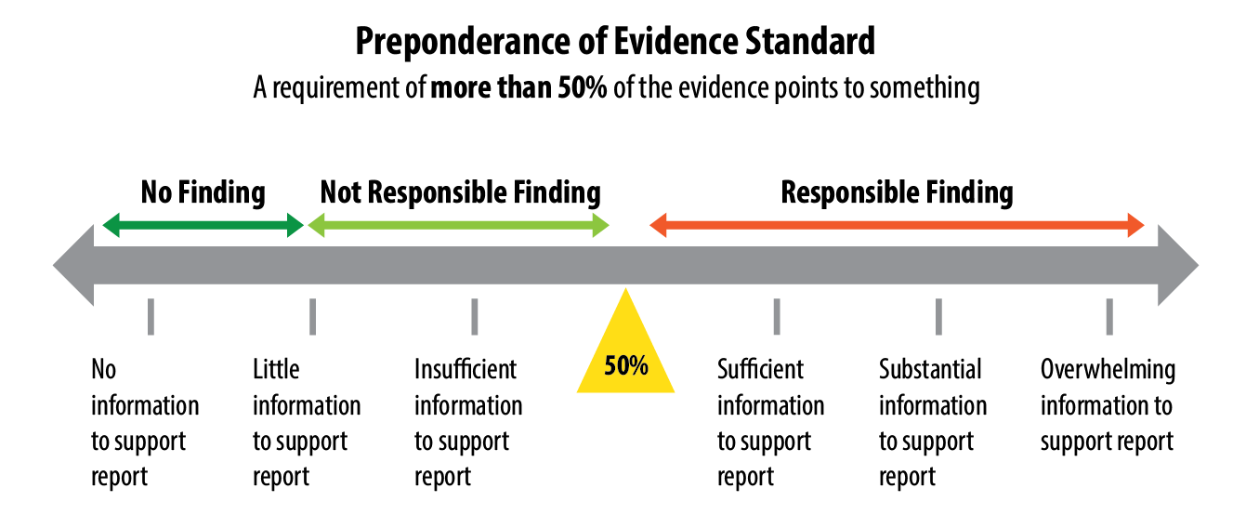
Preponderance of Evidence Standard
Notes:
The Preponderance of Evidence Standard is the evidence standard used by NSCS.
The preponderance of evidence standard comes into play when one party satisfies the burden of proof by offering evidence that demonstrates their claims have a greater than 50% chance to be true. In other words, if a claim can be demonstrated to be more likely to be true than not true, the burden of proof is met.
For example, Student A is attempting to prove that they were sexually harassed by Student B. Student A must convince the panel that it is more probable than not that Student B sexually harassed them.

Slide 12
Cross Examination
  Must allow each party’s advisor to cross-examine the other party and any witnesses
  Cross-Examination at the live hearing must be conducted directly, orally, and in real time by the party’s advisor and never by a party personally
Notes:
Please see the Hearing Template for information regarding conducting proper cross examination.

Slide 13
After the Hearing
Module 5G

Slide 14
Deliberations
  Private deliberation with only the panelists
  Unanimous decision is NOT required
  Issue a written decision of findings
Notes:
Private deliberations with only the panelists. Any person(s) that were not on the hearing panel are barred from participating. This includes the Title IX Coordinator and other Title IX staff that were not on the hearing panel.
Unanimous decision is not required. The Chairperson decision will reign supreme with or without majority.
Once Deliberations are complete, you must issue a written decision of the findings.

Slide 15
The Written Decision
  Summarize evidence supporting the decision
  Provide to BOTH parties
    Any and All allegations
    Summary of all procedural steps taken from compliant to final determination
    All findings that support the final determination
    Determinations of sanctions, with supporting evidence
    Relevant information on the appeal process
Notes:
The Written Decision must include:
Any and All evidence supporting the decision. This includes the initial report, the formal complaint, any information gathered during the decision and the hearing.
Any and All allegations.
Summary of all procedural steps taken from complaint to final determination.
Determinations of sanctions, with supporting evidence.
Relevant information on the appeal process.

Slide 16
Case Studies
Module 5G

Slide 17
Case Study 1
  A hearing has been scheduled for June 21st at 2pm. Both parties have been given notice of the date and time of the hearing. Only the Respondent has confirmed that they will be present and in person at the hearing. The hearing is set to take place at the atrium inside the Student Center. At the hearing, both parties have equal access to the same restroom and privacy areas. The hearing was not audio recorded but a transcript was written. Have all the proper procedures been followed? Please identify the problem areas.
Notes:
Problem Area 1: In this fact pattern, only the date and time of the hearing was provided to both of the parties. However, this is not the correct approach. Under the rules, all participants must be provided with not only the date and time of the hearing, but also the location of the hearing.
Problem Area 2: The hearing is set to take place at the atrium inside the Student Center. However, this is not the correct approach. Under the rules, the hearing must be held in a private space either virtual or in-person.
Problem Area 3: Both parties have equal access to the same restroom and privacy areas. However, this is not the correct approach. Under the rules, each party must have their own restrooms and private areas to avoid any potential conflicts.
Problem Area 4: The hearing was not audio recorded but a transcript was written. This is the correct approach. Although, the hearing was not audio recorded, a transcript was written.

Slide 18
Case Study 2
  At present, student A alleges that student B sexually assaulted them in their dorm. At a live hearing, the respondent asks the complainant, “What color shirt was I wearing during the night of the party”. In response, the complainant states that the respondent was wearing a “red shirt”. This answer is inconsistent with the answer given by the complainant in the initial report. Determine if the information is relevant and if so, why? Determine if the complainant’s testimony is credible and if so, why? Have all proper cross-examination procedures been followed?
Notes:
Is the information relevant? Most likely not. Remember, information is relevant if it helps to prove or disprove a fact. In this fact pattern, the color of the shirt worn by either party is most likely irrelevant to the facts in question.
Is the information credible? Most likely, yes. Remember, memory errors do not necessarily destroy a witness’s credibility. For more information, please refer to your Hearing One Sheet.
Proper Cross Examination? No, proper cross examination procedures have not been followed. Remember, cross examination can never be conducted by a party, personally. It must be conducted through their advisor.

Slide 19
Case Study 3
  Once the hearing has concluded, all the panel members and the VP of Student Affairs meet in a private room to deliberate. Even though the decision was not unanimous, the chairperson speaks with both parties to inform them of the final determination. During this conversation, the chairperson informs them of all the allegations set forth and all the evidence considered in making the final determination. Have all the proper procedures been met? Please identify the problem areas.
Notes:
Problem Area 1 –All the panel members and the VP of Student Affairs meet in a private room to deliberate. This is not the correct approach. Remember, only panel members are allowed to deliberate in a private space.
Problem Area 2- Even though the decision was not unanimous, the chairperson speaks with both parties to inform them of the final determination. This is not the correct approach. Remember, a WRITTEN notice of findings is required. It must be written and cannot be communicated orally.
Problem Area 3- During this conversation, the chairperson informs them of all the allegations set forth and all the evidence considered in making the final determination. This is not the correct approach. Remember, the written decision must include, Any and All allegations, Summary of all procedural steps taken from compliant to final determination , All findings that support the final determination, Determinations of sanctions, with supporting evidence , Relevant information on the appeal process.

